Slide 1
Eald Englisc Flyting

Slide 2
Prologue

Slide 3
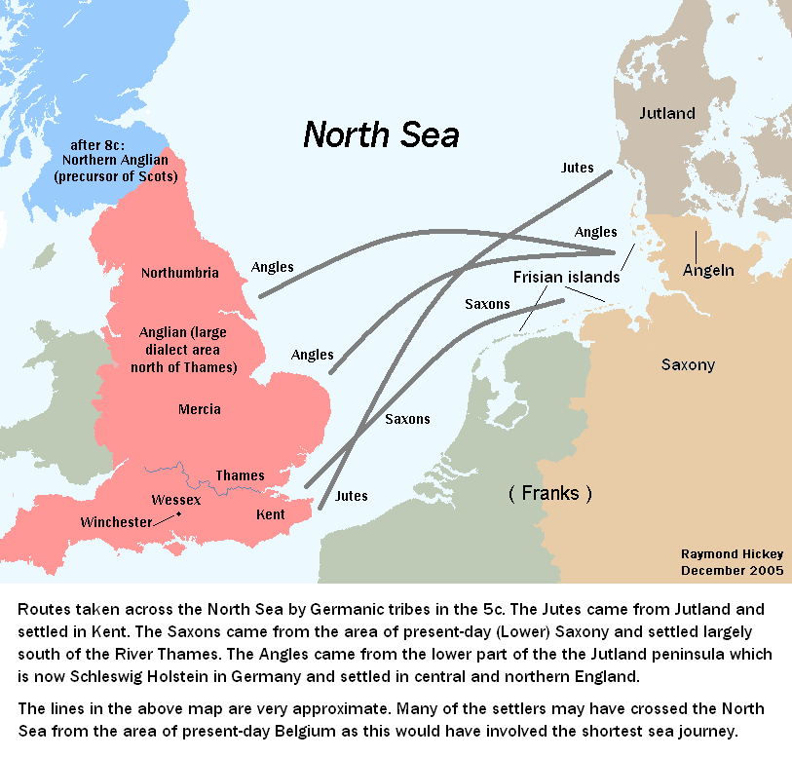

Slide 4
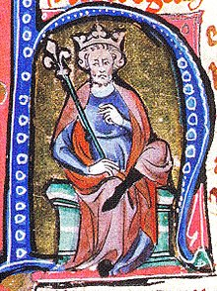

Slide 5
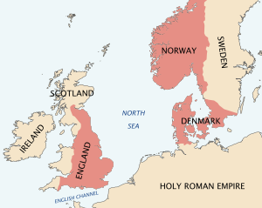
Notes:
So I’d like you all to imagine this: It’s 1019, a millennium ago. This is an interesting time, as Cnut the great was the king of England, Norway and Denmark. Most of England was either owned by Vikings or being constantly raided by Vikings, and this heavily impacted our culture.

Slide 6
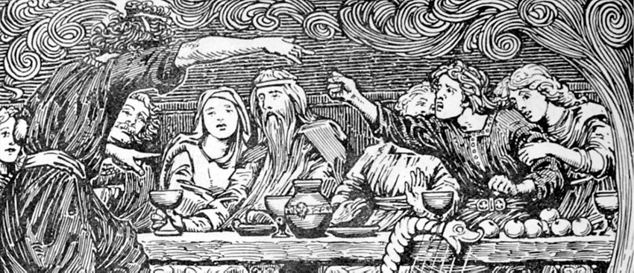
Notes:
As you walk into a tavern you’d hear more than just Old English, but also Old Norse and perhaps the languages of foreign traders from Wales, Scotland, or Normandy. You see roaring fires, fresh meat off the bone, loud laughing as men drink together. But as news spreads about a nearby Viking raid, much of the conversation is concerning politics. After all, Cnut Cyng had been crowned only three years ago in 1016 and many people were not satisfied with his leadership. And for those of you who don’t know, politics and beer don’t mix well. An Angle from Cantwaraburh, once known as Durovernum Cantiacorum, before that in a lost Celtic name, and now known as Canterbury, stands up and bellows an insult about the great Cyng himself: Se Cyng is Swīn! A Jute stood up from across the room, beer dripping from his beard, nā, þū said he. In drunken rage, these two men gathered their brothers and friends to the center of the room for a great flyte. Not fight, flyte. Indeed, one of the most iconic features of a Nordic duel, the insult battle.

Slide 7
Part One

Slide 8
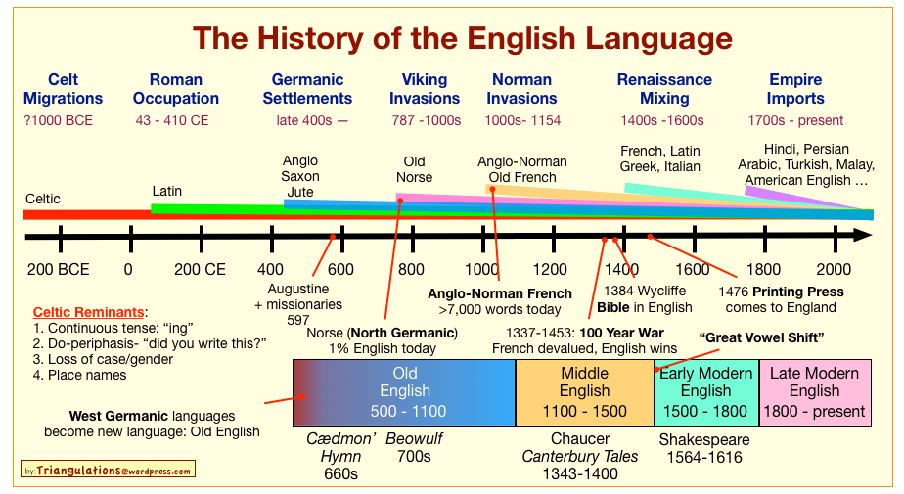
Notes:
Most info from beowulf time, but this takes place in 1019. 300 year difference, so things you find online may be different from source to source, but it’s all fair game.

Slide 9
Pronunciation
Hwæt. We Gardena in geardagum,
þeodcyninga, þrym gefrunon,
hu ða æþelingas ellen fremedon. Oft Scyld Scefing sceaþena þreatum...
Notes:
Pronounce everything, like Latin or German
R sound
H sounds (cniht)
G sounds
Þ and ð
Æ sound
Sc is sh
F and v

Slide 10
Pronouns
1st Person
I - Iċ
Me - me
We - ƿe
You and I - ƿit
Us - unc (d)
us (pl)
My - min
Our - uncer (d),
ure (pl)
2nd Person
You/thou - þu
You/thee - þe
You two - ȝit
Y’all/ye - ȝe
Your - þin
Y’all’s/ye’s - inċer (d)
eoƿer (pl)
3rd Person
He - he
Him - him
It - hit
She - heo
Her - hire
They - hie/þie
Them - him/þim
Notes:
Discuss dual, ċ, wynn, and yogh. Oversimplify time.

Slide 11
Verb “To Be”
Wesan
I am - iċ eom
You are - þu eart
he/she/it is - he/heo/hit is
We/ye/they - we/ge/hie sindt
Notes:
Leorningcildru, endemes!
Talk about sindt

Slide 12
Articles & Demonstratives
Articles
The - þaet
A/An - Hwaet is þaet?
Demonstratives
That - þaet
Those - þa
This - þis
These - þas
Notes:
Here’s some practice. There wasn’t an indefinite article. Mention genders. Se Cyng is Swīn.

Slide 13
Part Two

Slide 14
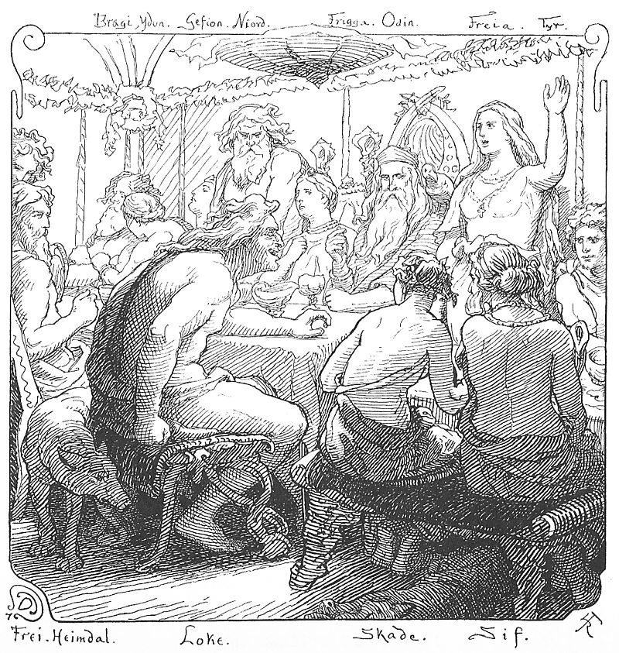
Flyting?
Notes:
So I’m sure by now all of you have some sort of an idea of what flyting is. It comes from and Old English word flītan meaning quarrel. It’s medieval Nordic cultural ritual where two people or groups would insult each other in provocative ways. Talk about the word Aergr, how people tended to insult each other.
Sometimes it would commence in a bar fight or before a duel, but in Old England, it was just often all fun and games. Two people would flyte, and the winner got the loudest reactions from the crowd. Then the winner would get a large stein of mead, and if he or she (will explain in sec) was kind and permitted it, the looser would also get a drink.
Explain the picture
Fun fact: in late medieval England, a noble would get fined 20 shillings if he used profanity and servants would get whipped. Unless if they were flyting, then even the king would have bards flyte during a feast as entertainment.

Slide 15
Instructions for Use
Boast
Defense
Conclusion
Notes:
Done in verse, played on words and made up words (called kennings)
Boast: Here the challenger will stand and boast about himself, then the challenged gets a chance
Defense: Both sides insult each other (don’t have time for rebuttal)
Conclusion: The final slam for both sides starting with the challenger. Completes why they’re the best or while the other person is simply worse.

Slide 16
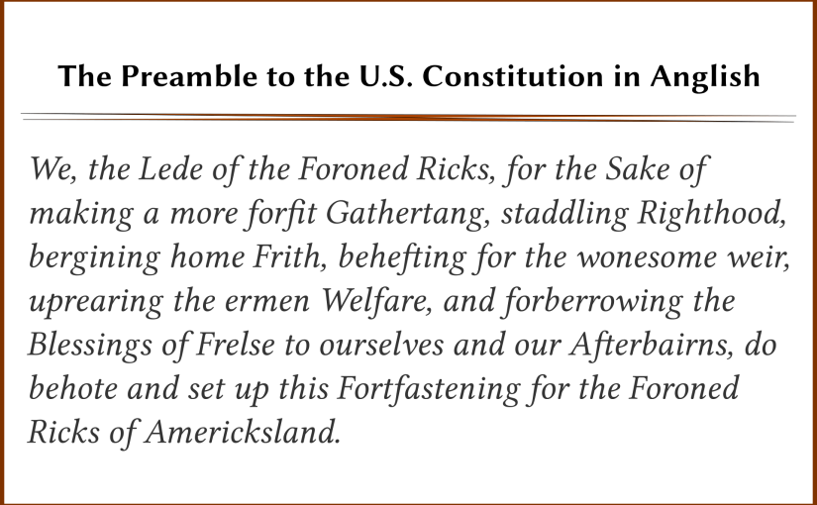
Disclaimer
Notes:
So this is an example of the sort of thing you can find online when you’re studying Old English and Viking history, cool eh? This is actually the Anglish, which is English with all of the Romance language words taken out, but you’re going to find the same sort of people who are into that who are into Old English. Now obviously it’s not everyone, but many of the people are racists. Anglish is a form of English linguistic puritanism, where everything which isn’t considered part that pure, Aryan tongue is taken out. Anglish is interesting to look at linguistically speaking, but most of the people who were on it are racists. Nordic mythology, Old English, Vikings, all of these are the kind of things racists from the Soldiers of Odin (An anti-immigrant white supremacist Canadian and Scandanavian group) to Heinrich Himmler. Watch out for these people when researching, I’ve seen them myself, and don’t fall into their traps.

Slide 17
Part Three

Slide 18
Time to Flyte
You’ll be split up into two groups
Write at least one sentence for each flyting stage together (have translation!)
The skalds will flyte
The winner will get some “mead!”
Notes:
So, back to that to that tavern in 1019 England. After that short exchange of words concerning Cnut Cyng by the Angle and the Jute, they agree to flyte. They crowd roars in excitement as the two large drunk men roll up their sleeves. The crowd starts to chant “flyte flyte flyte.”
I’ll split them up into two groups, and have them split themselves into three subgroups for the boast, defense and conclusion. They’ll have whatever time is left minus five minutes to work together to write down their prepared flytes. Then, skald(s) will represent both groups and they will flyte. I’ll decide the winner and they get the stein for a bit.

Slide 19
Sources
Notes:
https://www.lexilogos.com/english/english_old.htm
https://en.wikipedia.org/wiki/Old_English_grammar#Definite_articles_and_demonstratives
https://en.wiktionary.org/wiki/wesan#Old_English

Slide 20
Outline
First Half: 40 mins
Intro
Old English
Pronunciation
Define grammatical terms
Basics of conjugations, articles, and pronouns
Use of flyting
Structure of flyting
Disclaimer
Second Half: 40 mins
Intro to assignment
Give them the resources
Split them into groups
Let them work together
presentation

